Slide 1




Slide 2
CHAPTER 13
FORM ENHANCEMENT & VALIDATION

Slide 3
Form enhancement makes forms easier to use.
Validation ensures that you are getting the right information from users.

Slide 4
Examples in this chapter use helper functions. They add cross-browser event handlers.

Slide 5
Helper function to add events: function addEvent(el, event, callback) {
// If addEventListener works use it if ('addEventListener' in el) { el.addEventListener(event, callback, false);
} else {
// Otherwise create IE fallback el['e' + event + callback] = callback; el[event + callback] = function () { el['e' + event + callback](window.event);
}; el.attachEvent('on' + event, el[event + callback]);
}
}

Slide 6
DOM nodes for form controls have different properties and methods than other elements.

Slide 7
properties methods events action submit() submit method reset() reset name elements
<form> ELEMENT

Slide 8
properties methods events value focus() blur type blur() focus name select() click disabled click() change checked input selected keyup form keydown defaultChecked keypress
FORM CONTROLS

Slide 9
WORKING WITH FORMS

Slide 10
SUBMITTING FORMS

Slide 11
To work with a form’s content, use the preventDefault() method of the event object to stop it from being sent.

Slide 12
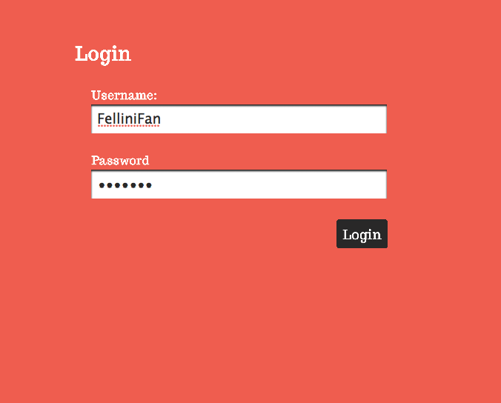

Slide 13
Submitting a form:
(function() { var form = document.getElementById('login'); // Form element addEvent(form, 'submit', function(e) { // On submit e.preventDefault(); // Stop it being sent var elements = this.elements; // Get form elements var username = elements.username.value; // Get username var msg = 'Welcome ' + username; // Welcome message
// Write welcome message document.getElementById('main').textContent = msg;
});
}());

Slide 14
TYPE OF INPUT

Slide 15
The type property of an input corresponds with the type attribute in HTML.
(It won’t work in IE8 or earlier.)

Slide 16
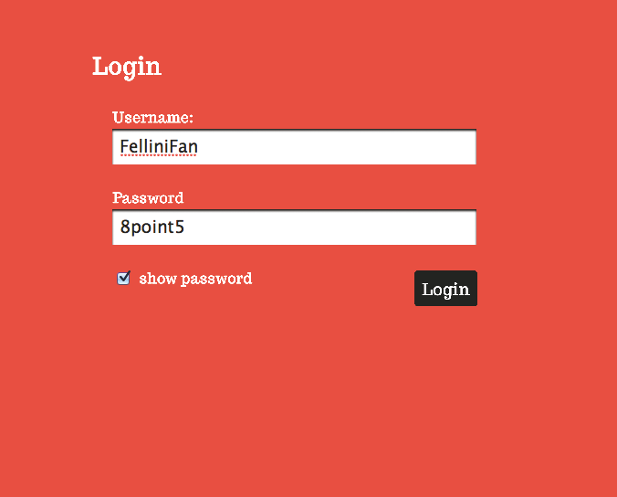

Slide 17
Showing a password: var pwd = document.getElementById('pwd'); // Get pwd input var chk = document.getElementById('showPwd'); // Get checkbox addEvent(chk, 'change', function(e) { // Click on checkbox var target = e.target || e.srcElement; // Get that element try { // Try following code if (target.checked) { // If checked set pwd.type = 'text'; // type to text
} else { // Otherwise set pwd.type = 'password'; // type to password
}
} catch(error) { // If an error alert('This browser cannot switch type'); // Show warning
}
});

Slide 18
DISABLE INPUTS

Slide 19
The disabled property of an input corresponds with the disabled attribute in HTML.

Slide 20
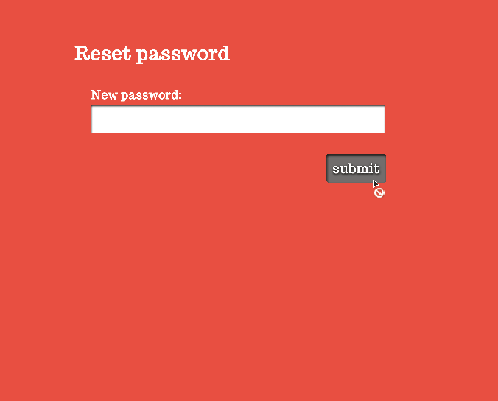

Slide 21
Disabling a submit button: var form = document.getElementById(‘newPwd'); // Form var password = document.getElementById('pwd'); // Password var submit = document.getElementById('submit'); // Submit var submitted = false; // Has form been submitted? submit.disabled = true; // Disable submit button submit.className = 'disabled'; // Style submit button

Slide 22
CHECKBOXES

Slide 23
The checked property of an input corresponds with the checked attribute in HTML.

Slide 24
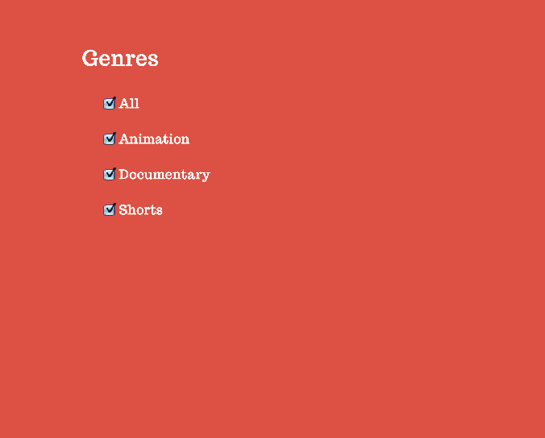

Slide 25
Selecting all checkboxes: var form = document.getElementById('interests'); // Form var elements = form.elements; // Elements in form var options = elements.genre; // Genre checkboxes var all = document.getElementById(‘all'); // 'All' checkbox function updateAll() { for (var i = 0; i < options.length; i++) { // Each checkbox options[i].checked = all.checked; // Update property
}
} addEvent(all, 'change', updateAll); // Event listener

Slide 26
RADIO BUTTONS

Slide 27
The checked property is also commonly used with radio buttons.

Slide 28
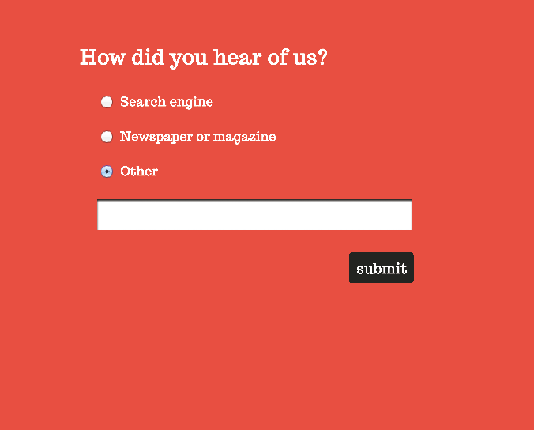

Slide 29
Showing a text input: options = form.elements.heard; // Radio buttons other = document.getElementById(‘other'); // Other button otherText = document.getElementById(‘other-text'); // Other text otherText.className = ‘hide'; // Hide other for (var i = [0]; i < options.length; i++) { // Each option addEvent(options[i], 'click', radioChanged); // Add listener
} function radioChanged() { hide = other.checked ? '' : 'hide'; // Is other checked? otherText.className = hide; // Text input visibility if (hide) { // If text input hidden otherText.value = ''; // Empty its contents
}
}

Slide 30
SELECT BOXES

Slide 31
Select boxes have more properties and methods than other form controls.
The <option> elements hold the values select boxes contain.

Slide 32
properties methods options add() selectedIndex remove() length multiple selectedOptions
SELECT BOXES

Slide 33
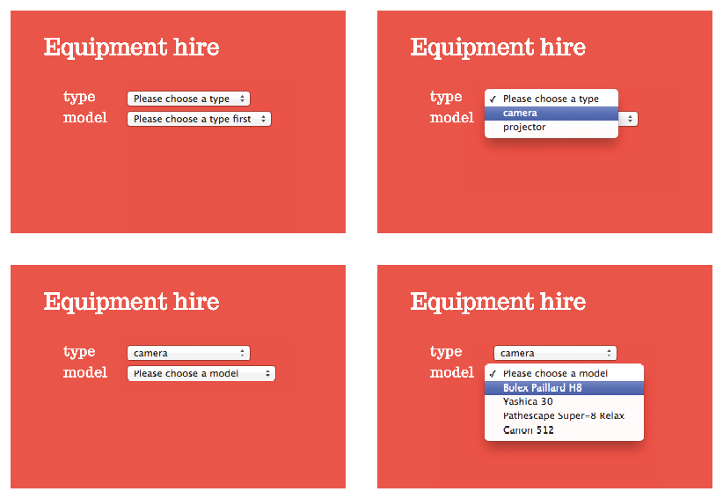
1
2
3
4

Slide 34
Info for select boxes is stored in objects:
// Type select box var type = document.getElementById(‘equipmentType');
// Model select box var model = document.getElementById('model'); var cameras = { // Object stores cameras bolex: 'Bolex Paillard H8', yashica: 'Yashica 30', pathescape: 'Pathescape Super-8 Relax', canon: 'Canon 512'
}; var projectors = { // Store projectors kodak: 'Kodak Instamatic M55', bolex: 'Bolex Sound 715', eumig: 'Eumig Mark S', sankyo: 'Sankyo Dualux'
};

Slide 35
Getting the right object: function getModels(equipmentType) {
// If type is cameras return cameras object if (equipmentType === 'cameras') { return cameras;
// If type is projectors return projectors object
} else if (equipmentType === 'projectors') { return projectors;
}
}

Slide 36
Populating select boxes: addEvent(type, 'change', function() { // Change select box if (this.value === 'choose') { // No selection made model.innerHTML = '<option>Please choose a type first</option>'; return; // No need to proceed
} var models = getModels(this.value); // Get right object var options = '<option>Please choose a model</option>'; var key; for (key in models) { // Loop through models options += '<option value="' + key + '">' + models[key]
+ '</option>';
} model.innerHTML = options; // Update select box
});

Slide 37
TEXTAREA

Slide 38
The value property gets and updates the value entered into a textarea or text input.

Slide 39
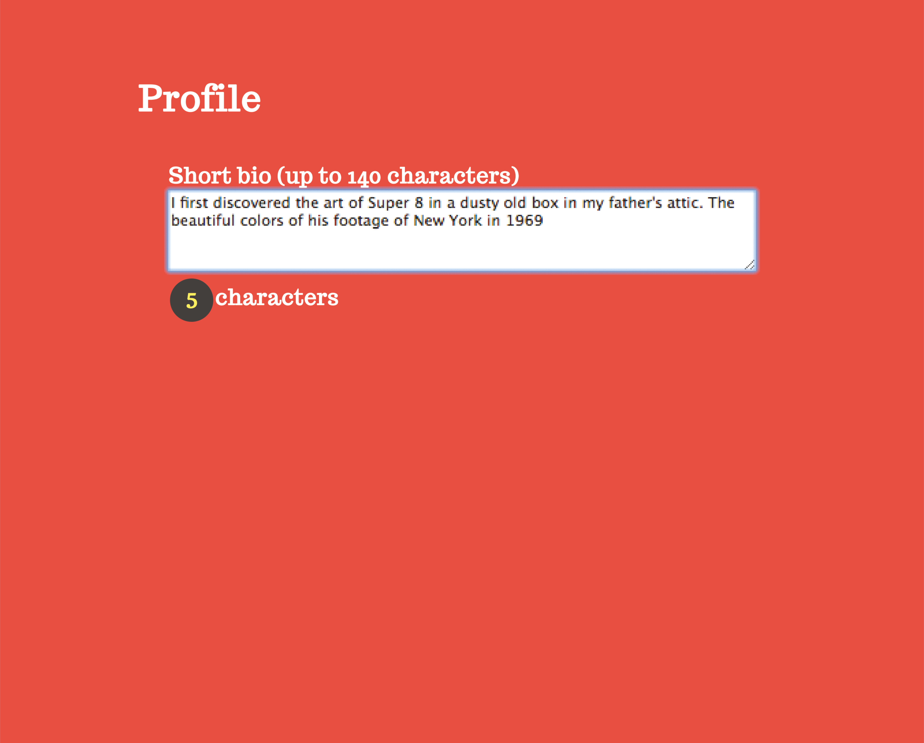

Slide 40
Set-up and event handling:
(function () { var bio = document.getElementById(‘bio'); var bioCount = document.getElementById('bio-count');
// Call updateCounter() on focus or input events addEvent(bio, 'focus', updateCounter); addEvent(bio, 'input', updateCounter); addEvent(bio, 'blur', function () { // Leaving the element if (bio.value.length <= 140) { // If bio not too long bioCount.className = 'hide'; // Hide the counter
}
});

Slide 41
Updating the counter: function updateCounter(e) { var target = e.target || e.srcElement; // Get target of event var count = 140 - target.value.length; // Characters left if (count < 0) { // Less than 0 chars bioCount.className = 'error'; // Add class of error
} else if (count <= 15) { // Less than 15 chars? bioCount.className = 'warn'; // Add class of warn
} else { // Otherwise bioCount.className = 'good'; // Add class of good
} var charMsg = '<b>' + count + '</b>' + ' characters'; // Msg bioCount.innerHTML = charMsg; // Update counter
}

Slide 42
HTML5 ELEMENTS
& ATTRIBUTES

Slide 43
HTML5 added form elements and attributes that perform tasks that had previously been done by JavaScript.

Slide 44
In particular, the elements can check that the user entered the right kind of information.
If not, they show an error.
This is known as validation.

Slide 45
EMAIL, PHONE & URL

Slide 46

<input type=“email”>
<input type=“url”>
<input type=“telephone”>
SAFARI
FIREFOX
CHROME

Slide 47
SEARCH

Slide 48

<input type=“search” placeholder=“search” autofocus>
SAFARI
FIREFOX
CHROME

Slide 49
NUMBER

Slide 50

<input type=“number” min=“0” max=“10” step=“2” value=“6”>
SAFARI
FIREFOX
CHROME

Slide 51
RANGE

Slide 52

<input type=“range” min=“0” max=“10” step=“2” value=“6”>
SAFARI
FIREFOX
CHROME

Slide 53
COLOR PICKER
(Chrome & Opera only)

Slide 54
<input type=“color”>
CHROME

Slide 55
DATE

Slide 56

<input type=“date”>
<input type=“month”>
<input type=“week”>
<input type=“time”>
<input type=“datetime”>
CHROME

Slide 57
HTML5 elements are not supported in all desktop browsers. (There is much better support on mobile.)
When they are supported, they can look very different.

Slide 58
To get around this lack of support, you can use polyfills or feature detection.

Slide 59
FORM VALIDATION

Slide 60
Form validation checks that users enter data in the right format. If not, an error message is shown to users.

Slide 61
Generic checks are the kind that would be performed on different kinds of form.
If it uses the required attribute, does it have a value?
Does the value match what is indicated by the type attribute?

Slide 62
Custom validation tasks correspond to specific requirements of a given form.
If the user’s bio less than 140 characters?
If the user is under 13, is the parental consent checkbox selected?

Slide 63
Check every element before submitting the form so you can show all errors at once.

Slide 64
You can create an object to keep track of each element and whether its entry is valid.
To check if you can submit the form, check the valid object.

Slide 65
The last example in the book uses JavaScript for validation and HTML5 validation as a fallback. This gives maximum visual consistency, and browser compatibility.

Slide 66
Checking if a required input has a value uses three functions: function validateRequired(el) { if (isRequired(el)) { var valid = !isEmpty(el); if (!valid) { setErrorMessage(el, ‘Field required’);
} return valid;
} return true;
}

Slide 67
The isRequired() function checks if it has the required attribute: function isRequired(el) { return ((typeof el.required === ‘boolean’) && el.required)
||(typeof el.required ===‘string’);
}
The isEmpty() function checks if the element is empty: function isEmpty(el) { return !el.value || el.value === el.placeholder;
}

Slide 68
Error messages can be stored with the element using jQuery’s data() method: function setErrorMessage(el, message) {
$(el).data(‘errorMessage’, message);
} function showErrorMessage(el) { var $el = $(el); var $errorContainer = $el.siblings(‘.error’); if (!$errorContainer.length) {
$errorContainer = $(‘<span class=“error”>
</span>’).insertAfter($el);
}
}

Slide 69
The type of content in a text input is validated using the validateTypes() function.

Slide 70
In turn, this function uses an object called validateType which has three methods to validate email addresses, numbers, and dates.

Slide 71
The validateType object uses regular expressions: var validateType = { email: function(el) { var valid = /[^@]+@[^@]+/.test(el.value); if (!valid) { setErrorMessage(el, ‘Please enter a valid email’);
} return valid;
}, number: function(el) {
// Check is a number
}, date: function(el) {
// Check date format
}
}

Slide 72
The validateType object is used by the validateTypes() function: function validateTypes(el) { if (!el.value) return true; var type = $(el).data(‘type’) || el.getAttribute(‘type’); if (typeof validateType[type] === ‘function’) { return valiudateType[type](el);
} else { return true;
}
}

Slide 73
Regular expressions search for characters that form a pattern. They can also replace those characters with new ones or simply remove them.

Slide 74
. single character (except newline)
[ ] single character in brackets
[^ ] single character not in brackets
\d digit
\D non-digit character
\w alphanumeric character
\W non-alphanumeric character
^ the starting position in any line
$ ending position in any line
* preceding element 0 or more times

Slide 75
Checking the length of the bio is an example of custom validation: function validateBio() { var bio = document.getElementById(‘bio’); var valid = bio.value.length <= 140; if (!valid) { setErrorMessage(bio, ‘Bio should not exceed 140 chars);
} return valid;
}

Slide 76
VALIDATION EXAMPLE OVERVIEW
A: Set up script
B: Perform generic checks
C: Perform custom validation
D: Did it pass validation?

Slide 77
Was the form valid? A flag is used to check through each item in the valid object:
// Loop through every form control - are there errors? for (var field in valid) { if (!valud[field]) { isFormValid = false; break;
} isFormValid = true;
} if(!isFormValid) { e.preventDefault;
}

Slide 78


